Slide 1
CHAPTER 13
MORPHOLOGICAL IMAGE
PROCESSING

Slide 2
WHAT WILL WE LEARN?
What is mathematical morphology and how is it used in image processing?
What are the main morphological operations and what is the effect of applying them to binary and grayscale images?
What is a structuring element (SE) and how does it impact the result of a morphological operation?
What are some of the most useful morphological image processing algorithms?

Slide 3
What is mathematical morphology?
Provide tools for representing, describing, and analyzing shapes in images
Extract geometrical and topological information through transformations using structuring element

Slide 4

FUNDAMENTAL CONCEPTS AND OPERATIONS
Set theory and set operations:
Union (∪)
Intersection (∩)
Complement
Difference of two sets A and B
Translation of set A by point w is denoted by Aw and defined as
Aw = {c|c = a + w, for a ∈ A}
The reflection of set A relative to the origin of a coordinate system is defined as
Matlab expression
OR (|)
AND (&)
NOT (˜)
(A & ˜B)

Slide 5
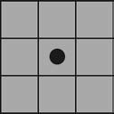
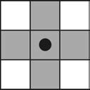
The Structuring Element (SE)
The structuring element is the basic neighborhood structure associated with morphological image operations
The black dot corresponds to their origin (reference point), the gray squares represent 1 (true), and the white squares represent 0 (false).

Slide 6
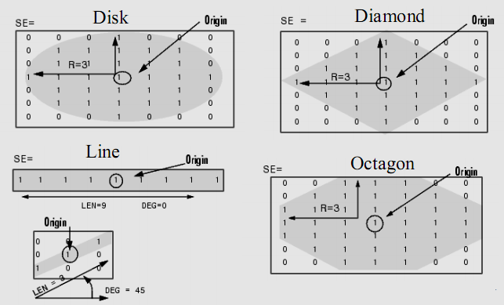
In MATLAB
strel: for creating structuring elements which supports arbitrary shapes, as well as commonly used ones, such as square, diamond, line, and disk.

Slide 7
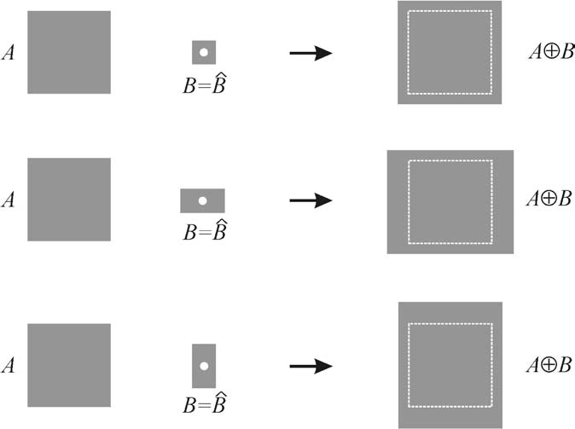

DILATION AND EROSION
Dilation is a morphological operation whose effect is to “grow” or “thicken” objects in a binary image
In Matlab: imdilate

Slide 8
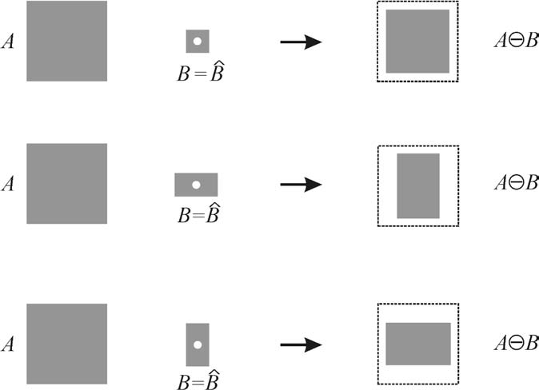

DILATION AND EROSION
Erosion is a morphological operation whose effect is to “shrink” or “thin” objects in a binary image
In Matlab: imerode

Slide 9
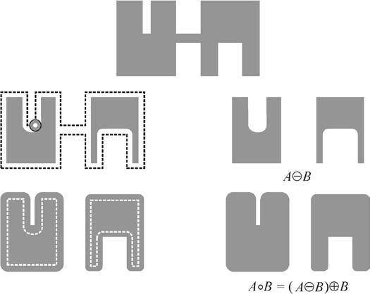

COMPOUND OPERATIONS
Opening: A ◦ B, is the erosion of A by B followed by the dilation of the result by B.
Opening is typically used to remove thin protrusions from objects and to open up a gap between objects connected by a thin bridge without shrinking the objects

Slide 10
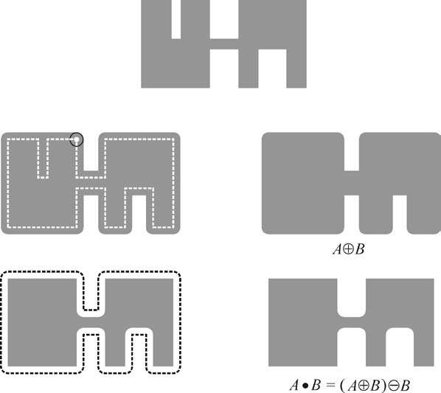

COMPOUND OPERATIONS
Closing: is the dilation of A by B followed by the erosion of the result by B
Closing is used to fill small holes, fuse narrow breaks, and close thin gaps in the objects within an image

Slide 11
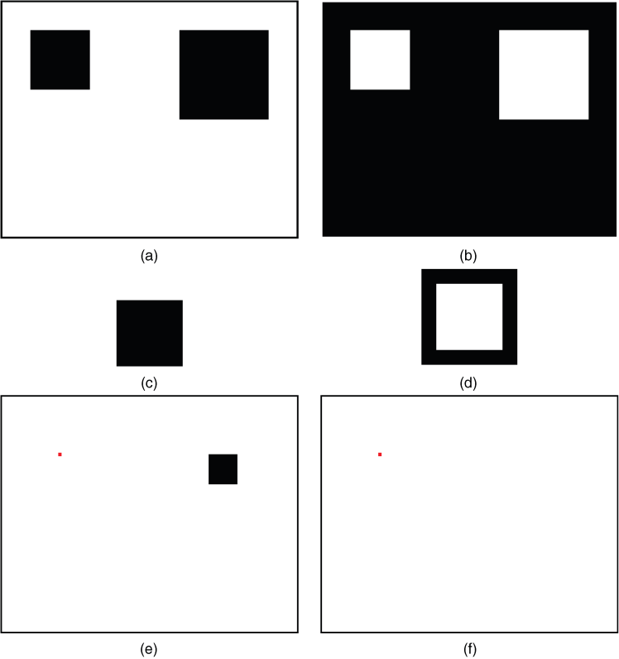

COMPOUND OPERATIONS
Hit-or-Miss Transform : uses two structuring elements (B1 and B2) designed in such a way that the output image will consist of all locations that match the pixels in B1 (a hit) and that have none of the pixels in B2 (a miss)
HoM transform can be used to locate squares of a certain size in a binary image

Slide 12

MORPHOLOGICAL FILTERING
Morphological filters are Boolean filters that apply a many-to-one binary (or Boolean) function h within a window W in the binary input image f (x, y), producing at the output an image g(x, y) given by
OR: is equivalent to a morphological dilation with a square SE of the same size as W.
AND: is equivalent to a morphological erosion with a square SE of the same size as W.
MAJ (Majority): is equivalent to a median filter applicable to binary images.

Slide 13



Boundary Extraction
Dilation, erosion, and set difference operations can be combined to perform boundary extraction of a set A, denoted by BE(A)
Internal Boundary: Consists of the pixels in A that sit at the edge of A
External Boundary: Consists of the pixels outside A that sit immediately next to A
Morphological Gradient: Consists of the combination of internal and external boundaries.

Slide 14
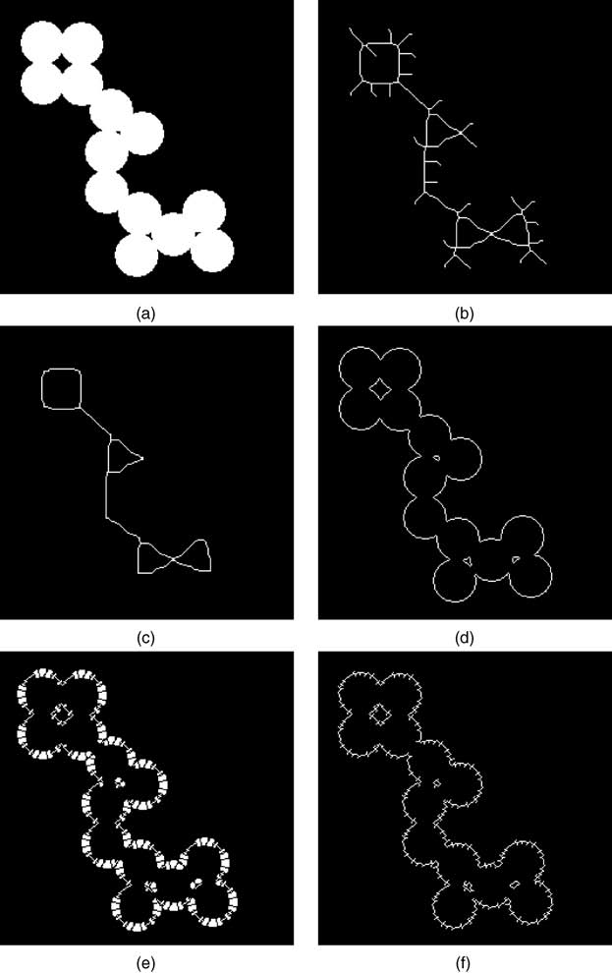
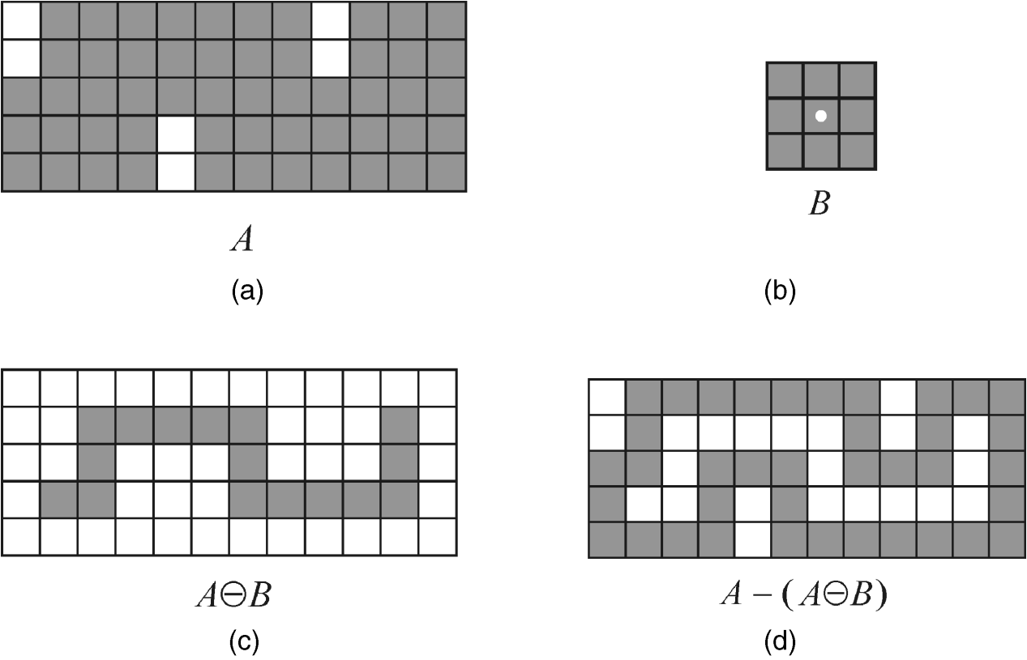

Slide 15
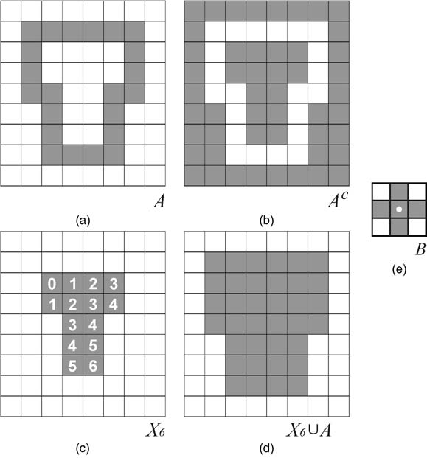
Region Filling
fill up the entire region with 1s using p as a starting point (i.e., setting it as 1).
Using an iterative procedure:
Xk = (Xk−1 ⊕ B) ∩ Ac k = 1, 2, 3, . .

Slide 16
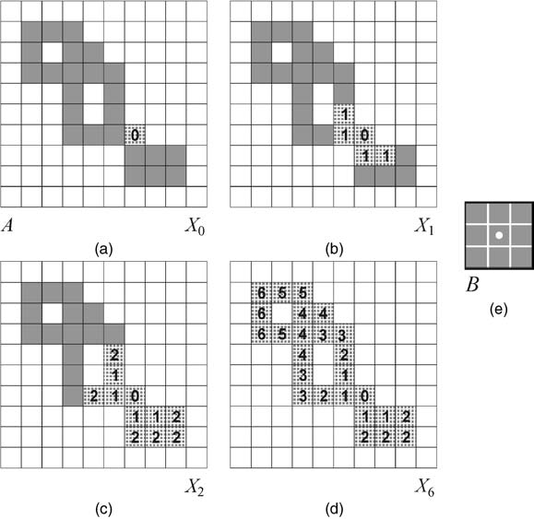
Extraction and Labeling of Connected Components
In Matlab: bwlabel
See Tutorial 13.2

Slide 17
GRAYSCALE MORPHOLOGY
Morphological operations can be extended to grayscale images.
The mathematical formulation of grayscale morphology uses an input image f(x,y) and a structuring element (SE) b(x,y).
Structuring elements in grayscale morphology: nonflat and flat.
In MATLAB: strel
Nonflat SEs can be created with the same function used to create flat SEs, but we must also pass a second matrix (containing the height values) as a parameter.

Slide 18

GRAYSCALE MORPHOLOGY
Dilation:
The dilation of an image f(x,y) by a flat SE b(x,y) is defined as:
where Db is called the domain of b.
For a nonflat SE, bN(x,y):

Slide 19

GRAYSCALE MORPHOLOGY
Erosion
The erosion of an image f(x,y) by a flat SE b(x,y) is defined as:
where Db is called the domain of b.
For a nonflat SE, bN(x,y):

Slide 20
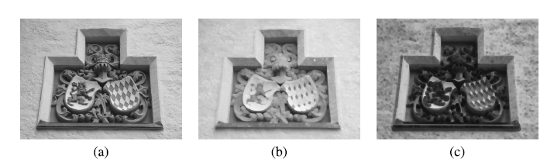
GRAYSCALE MORPHOLOGY
Example 13.8

Slide 21


GRAYSCALE MORPHOLOGY
Opening :
Closing

Slide 22
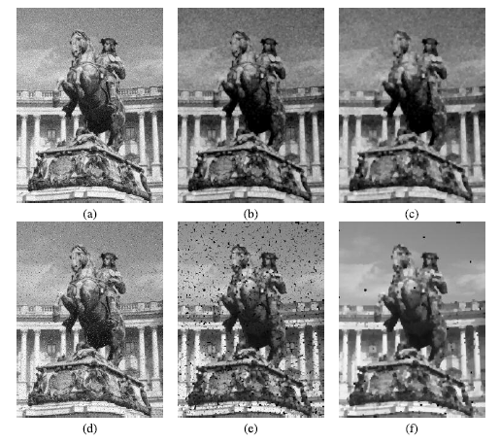
GRAYSCALE MORPHOLOGY
Example 13.9

Slide 23


GRAYSCALE MORPHOLOGY
Top-hat transformation
Bottom-hat transformation
In MATLAB: imtophat and imbothat

Slide 24
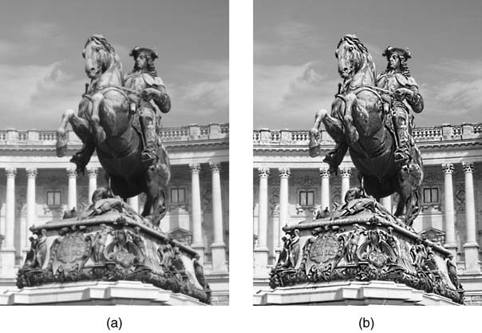
Top-hat and bottom-hat
Example 13.10

Slide 25
Hands-on
Tutorial 13.1: Binary morphological image processing (page 325)
Tutorial 13.2: Basic morphological algorithms (page 330)

